Slide 1


MANHOLE MONITORING
System Using IOT
55. Pranav Doshi
56. Vaishnavi Dudhe
58. Pavanraje Gaikwad
60. Nidhi Gandhi
61. Samika Gandhi

Slide 2
Purpose
To alert people about displacement of lid of manhole
To alert authority about missing of lid on manhole
To monitor and alert authority about leakage of toxic gas
To alert authoriy when water level goes beyond a safety level in sewage

Slide 3
REQUIREMNTS
To highlight circular outer border of man hole after diaplacement of lid
To alert autority and people within 10 sec after diplacememt of lid
Monitor the toxicity level of Methane and sulphur if threshold level is crossed initiate alert.
Monitor water level in the vertical sewage pipe below manhole if threshold level crossed initiate alert.
Remotely keep track of information related to manhole lid displacement.

Slide 4
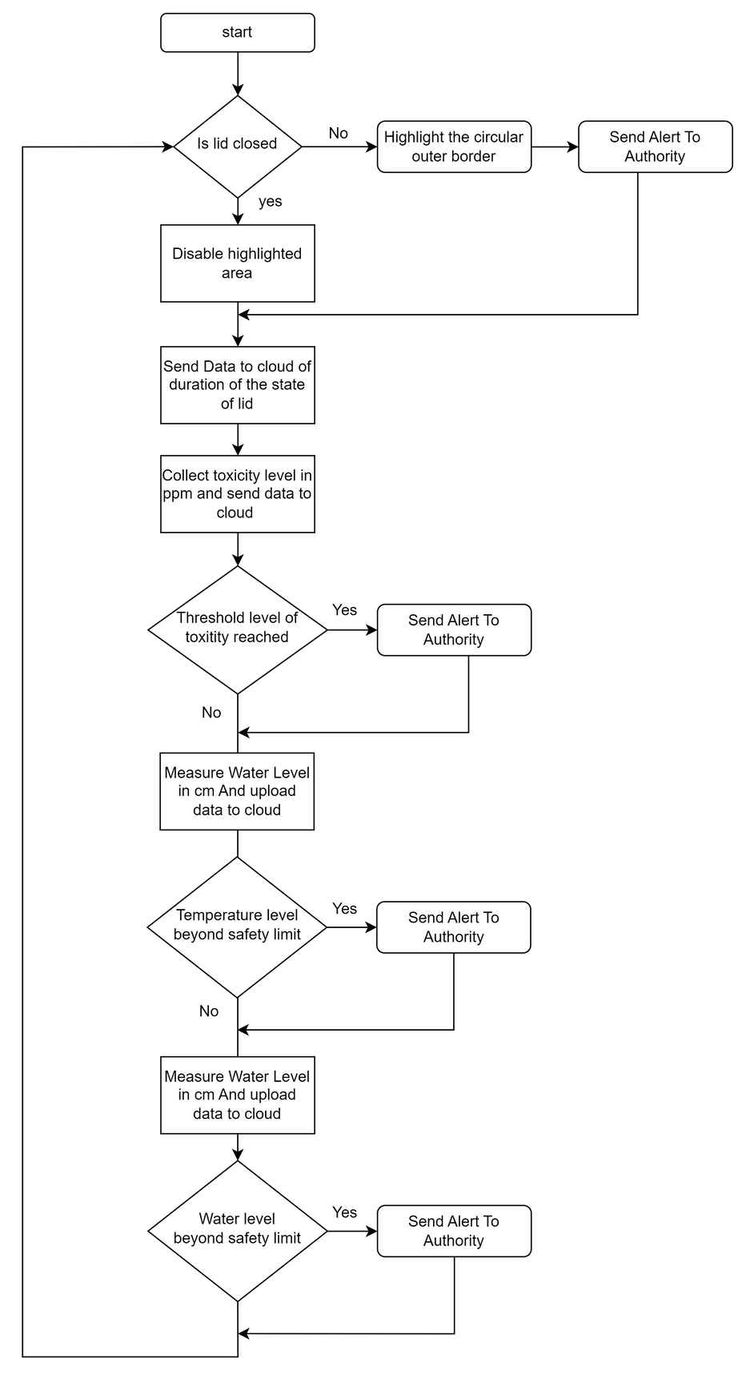
Process model
specification
Fig 1 : Flowchart

Slide 5
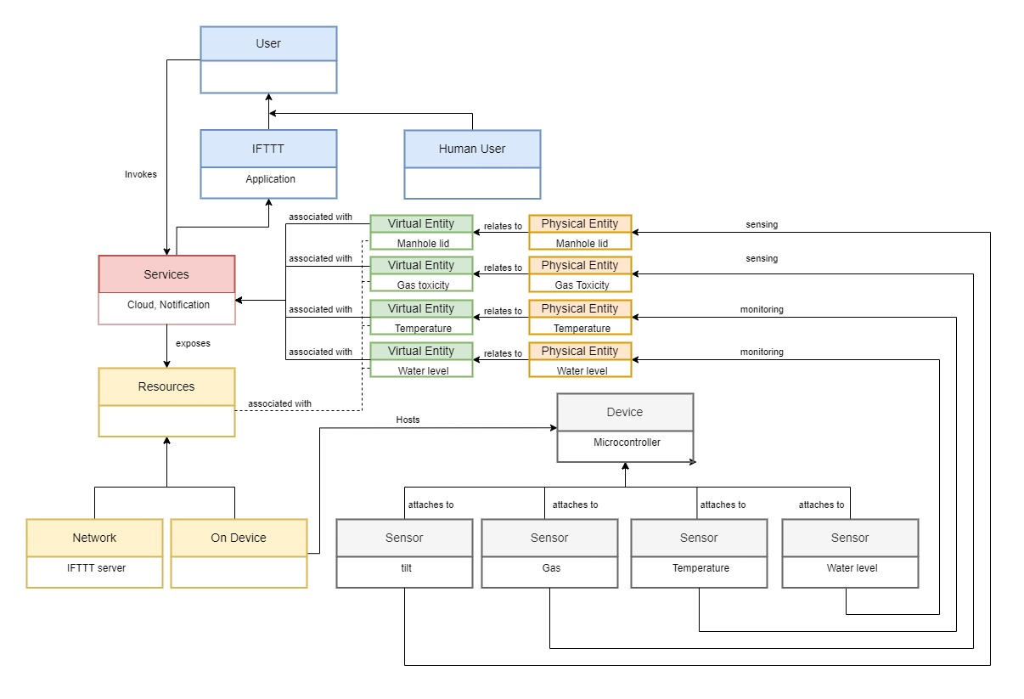
DOMAIN MODEL SPECIFICATION

Slide 6
INFORMATION MODEL SPECIFICATION
Virtual Entity
In manhole
Virtual Entity
Manhole lid
Gas Toxicity
has tilt level : high
has tilt level: low
has below 60%
Toxicity Level
has above 60%
Tilt level
State : on
State : off
state: off
state : on

Slide 7
INFORMATION MODEL SPECIFICATION
In Manhole
Virtual Entity
In Manhole
Virtual Entity
temperature
water level
has above 70C
Temperature
measure
has below 70C
is above 70 cm
Water Level
is below 70 cm
State : on
State :off
state: on
State : off

Slide 8
Service specification
Input
Schedule
Mode : Auto
Interval:
Every 10 seconds
Type : ON
Has a Input
Has Schedule
Services
Name:Web Services
Type:Cloud
Output
Has Output
Has Output
Output
State :
On/Off
Alert Notification

Slide 9
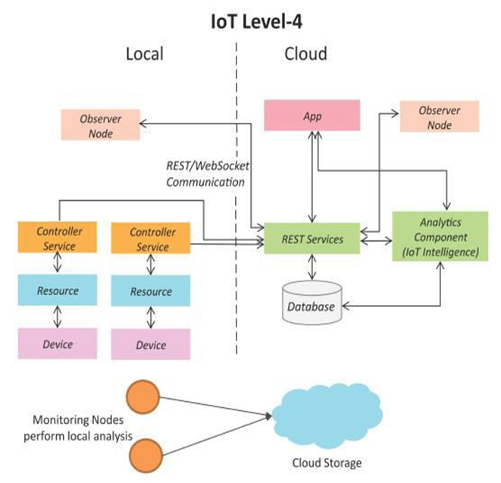
IOT Level specification

Slide 10

Functional view specification
Application
Web & Device App
Cloud Server
Management
Services
Security
Web Services
Databse
Authentication
Communication
Autherization
Device
Communication API
Device
Sensor
Output display
Microcontroller

Slide 11
Operational view specification
Application
Cloud Management : Thingspeak Server
Web App
Database Server
Web & Mobile App : For Notifications
Device Management : ESP 8266 Device
Management
Services
Security
Applicaiton Server : Local host web
Manegement
services
Databse
Web Services
Authentication
Device
Communication
Autherization
Device : ESP 8266 WiFi Module
Communication API
Authentication : Thingspeak & IFTTT
Sensors : MQ2 gas sensor, Tilt
Autherization: Thingspeak & IFTT
Temperature, Ultrasonic
Device
Output Display: LED
Device
Output display
Microcontroller

Slide 12
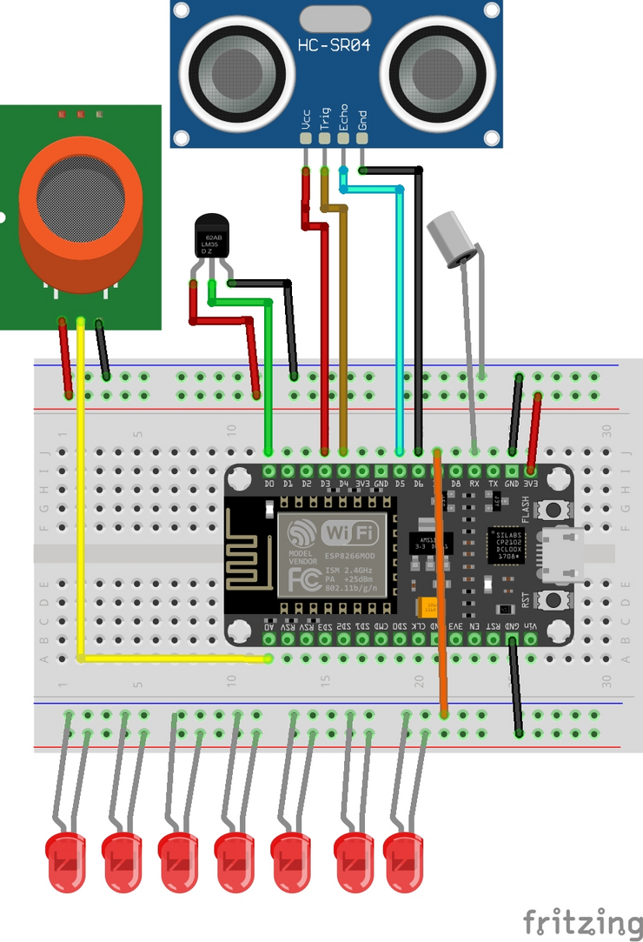
Device component integration
Fig 2 : Circuit diagram

Slide 13
Thank You !!

